Slide 1
Ekphrastic Poetry
Describing what you see.

Slide 2
What is ekphrasis?
Ekphrasis or ecphrasis is the graphic, often dramatic description of a visual work of art.

Slide 3
Today’s Learning Objective
How to use descriptive language through examining and recreating ekphrastic poetry.
You, the learner, will compose your own piece of ekphrastic writing.

Slide 4
"American Gothic" John Stone (1998)
Just outside the frame there has to be a dog chickens, cows and hay
and a smokehouse where a ham in hickory is also being preserved
Here for all time the borders of the Gothic window anticipate the ribs
of the house the tines of the pitchfork repeat the triumph
of his overalls and front and center the long faces, the sober lips
above the upright spines of this couple arrested in the name of art
These two by now the sun this high
ought to be in mortal time about their businesses
Instead they linger here within the patient fabric of the lives they wove
he asking the artist silently how much longer and worrying about the crops
she no less concerned about the crops but more to the point just now whether she remembered
to turn off the stove.

Slide 5
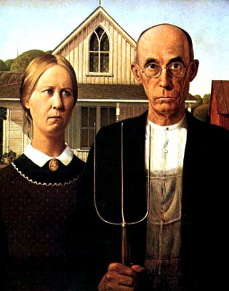
American Gothic

Slide 6
"Van Gogh's Bed" Jane Flanders (1985)
is orange, like Cinderella's coach, like the sun when he looked it straight in the eye.
is narrow, he sleeps alone, tossing between two pillows, while it carried him bumpily to the ball.
is clumsy, but friendly. A peasant built the frame; and old wife beat the mattress till it rose like meringue.
is empty, morning light pours in like wine, melody, fragrance, the memory of happiness.

Slide 7
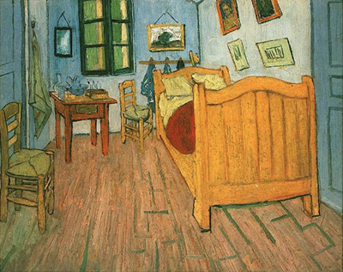
Vincent’s Bedroom in Arles

Slide 8
"Cezanne's Ports" Allen Ginsberg (1950)
In the foreground we see time and life swept in a race toward the left hand side of the picture where shore meets shore.
But that meeting place isn't represented; it doesn't occur on the canvas.
For the other side of the bay is Heaven and Eternity, with a bleak white haze over its mountains.
And the immense water of L'Estaque is a go-between for minute rowboats.

Slide 9
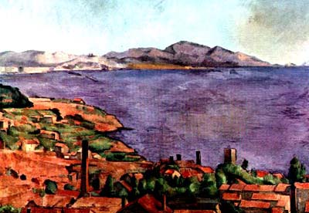

Slide 11
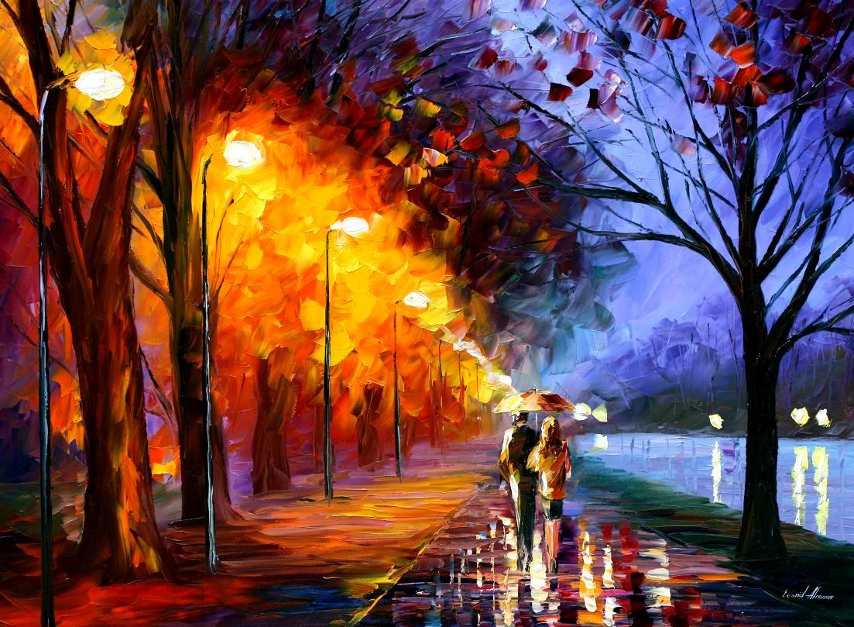
Write a poem that describes this:

